Slide 1
ME 494 - BTP
Control of Snake Robot
Guides: Prof. Debraj Chakraborty, Prof. Abhishek Gupta
– Saayuj Deshpande

Slide 2
Objective
To establish a simulation of the snake robot mimicking real world scenario and to test out new control algorithms in the simulation

Slide 3
Methodology
Utilized MATLAB’s Simscape multibody to create simulations of the snake robot
Tested Simscape-Gazebo co-simulation, but went ahead with Simscape due to simplicity and easy interpretation of signals

Slide 4
Simulation 1
Utilized CAD model of link and motor
Used rigid transforms to connect various links using dimensions from specification sheets
But this simulation had one link fixed to the world frame, so was only for visual purposes and a stepping stone for next simulation

Slide 5
Simulation 2
Modelled contact between the ground and the links using the 6 DoF joint and the Spacial Contact Block
Created a 10-link planar robot, which exhibited motion
Challenges faced:
Robot was sinking in intervals due to problem with ground contact
Planar robot exhibiting periodic circular motion, needed either anisotropic friction or serpenoid motion in 2 perpendicular directions

Slide 6
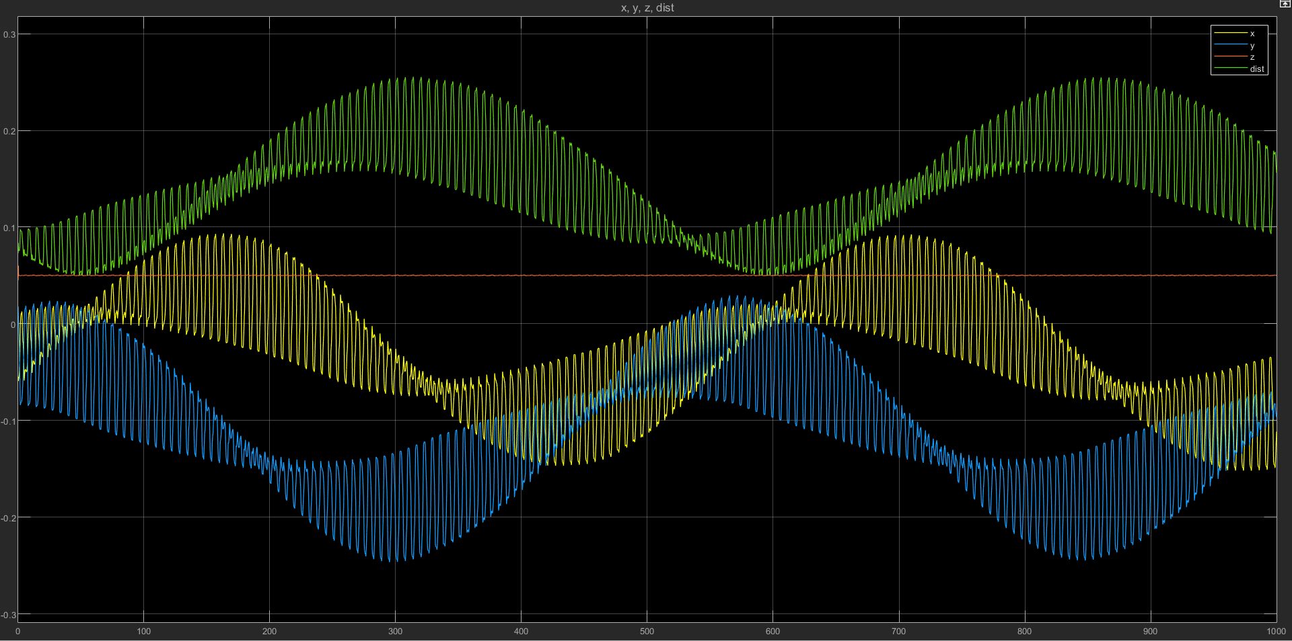
Plot of Displacement with Time

Slide 7
Studying and Testing the Spacial Contact block
Normal force and friction between block and ground was fluctuating a lot and was not settling easily, resulting in block falling through ground
Simscape uses a single point force to simulate contact at each time instant, resulting in block falling
Utilized contact proxies (spheres) at corners of cuboid to simulate contact with ground

Slide 8
Simulation 3
Created Simscape model of 10-link snake using cuboids as links
Revolute joints axes aligned alternatively perpendicular to each other
Contact proxies placed at all corners of links
Stiffness and damping calculated and given as input
Snake revolutes periodically when amplitudes and frequencies of the angular position profile input to the revolute joints are same
Promising results obtained for any asymmetry

Slide 9
Future Work
Model anisotropic friction
Optimize lifting of links

